Slide 1
Enhancing Product Development Efficiency at Ice Age Inc. PRESENTED BY Ogbonnah Augustine

Slide 2
A. Introduction B. Background C. Data Collection & Processing D. Exploratory Data Analysis E. Methodology F. Insights 1. Employee Analysis Dashboard 2. Market Analysis Dashboard 3. Product Analysis Dashboard G. Key Findings H. Competitor Analysis I. Recommendations J. Future Work K. Conclusion
Table of Contents

Slide 3


Introduction Objective: The project was initiated to enhance Ice Age Inc.'s product development efficiency, ensuring alignment with market demands and optimizing resource utilization. Focus Areas: We concentrated on analyzing resource allocation, streamlining development phases, and improving overall business performance.

Slide 4


Background Company Overview: Ice Age Inc. is an innovator in the technology industry, known for its cutting-edge products. The company is committed to continuous improvement and aims to optimize its product development processes to stay ahead in a competitive landscape. Project Goals: The key goals were to optimize resource allocation, streamline development processes, and align products with market demands to enhance customer satisfaction and success.

Slide 5
Data Collection and Processing:
Data Sources: Employee records, project management systems, and market performance databases were used.
Data Preparation: The data underwent rigorous cleaning and preprocessing to ensure accuracy, involving normalization and integration across various sources.
Key Data Elements: Employee data (skills, availability, performance), project data (development phases, budget adherence), and market data (competitor analysis, customer demographics).

Slide 6
Exploratory Data Analysis (EDA): The exploratory data analysis phase provided several key insights that informed the subsequent analysis and recommendations: Development Phase Distribution: Analysis revealed that certain development phases consistently exceeded budget and timelines, contributing to project delays and inefficiencies. Resource Allocation Patterns: High employee overload was identified, with specific teams being assigned more tasks than they could reasonably handle, leading to decreased productivity and potential burnout. Cost Overruns: A significant portion of projects experienced cost overruns, with actual costs consistently exceeding budgeted amounts. This issue was particularly acute in the later stages of product development.

Slide 7
Methodology: The methodology employed in this project involved a combination of data analysis techniques and strategic planning: Correlation Analysis: We conducted correlation analyses to identify relationships between employee skills, project assignments, and product success metrics, with a particular focus on cost overruns and employee workload. Market Comparison: Ice Age Inc.'s market performance was compared to that of small-sized competitors, using sales data, market share calculations, and cost efficiency metrics. Charts: Visual tools like Waterfall charts were used to map development phases and timelines, while radar Matrix tables facilitated a comparative analysis of performance metrics, including employee overload indices and cost management. Dashboards: Three Dashboards illustrates our analysis

Slide 8
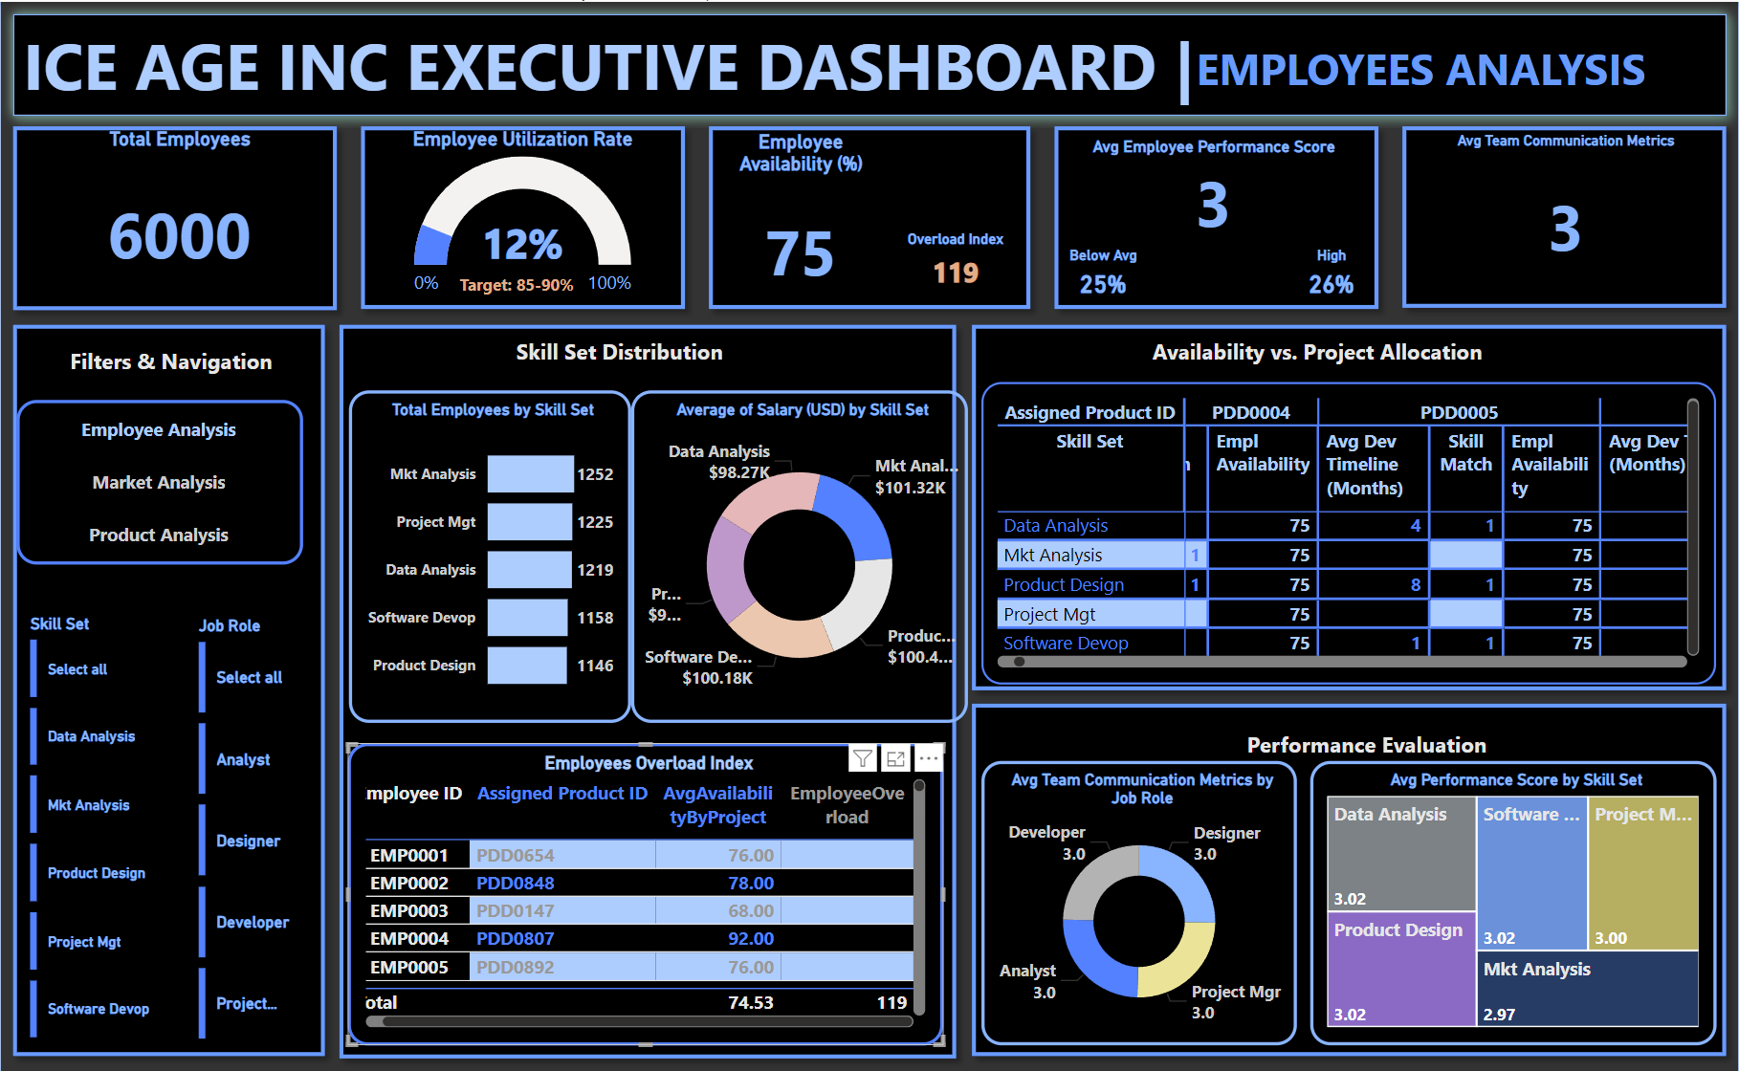

Slide 9
KEY INSIGHTS
Total Employees = 6,000
Employee Utilization Rate = 12% (Measure how effectively employees' time is being utilized, focusing on availability versus project allocation.) Expected = 80-90%
Employee Availability = 75%
Employee Overload = 119
Avg Employee Performance Score = 3 (Track the overall performance of employees.)
Below Avg rating = 25%
High rating = 26%
Medium + High Rating = 75%
Avg Team Communication Metrics = 3.
Skill Gaps: There are specific skill sets that are either underrepresented or overutilized, leading to potential employee burnout or skill gaps in critical areas.
Employee Allocation: Employees with lower availability percentages are often assigned to high-priority projects, resulting in delays and decreased performance.
Performance Disparities: High performers are not always allocated to the most critical projects, leading to suboptimal project outcomes.

Slide 10
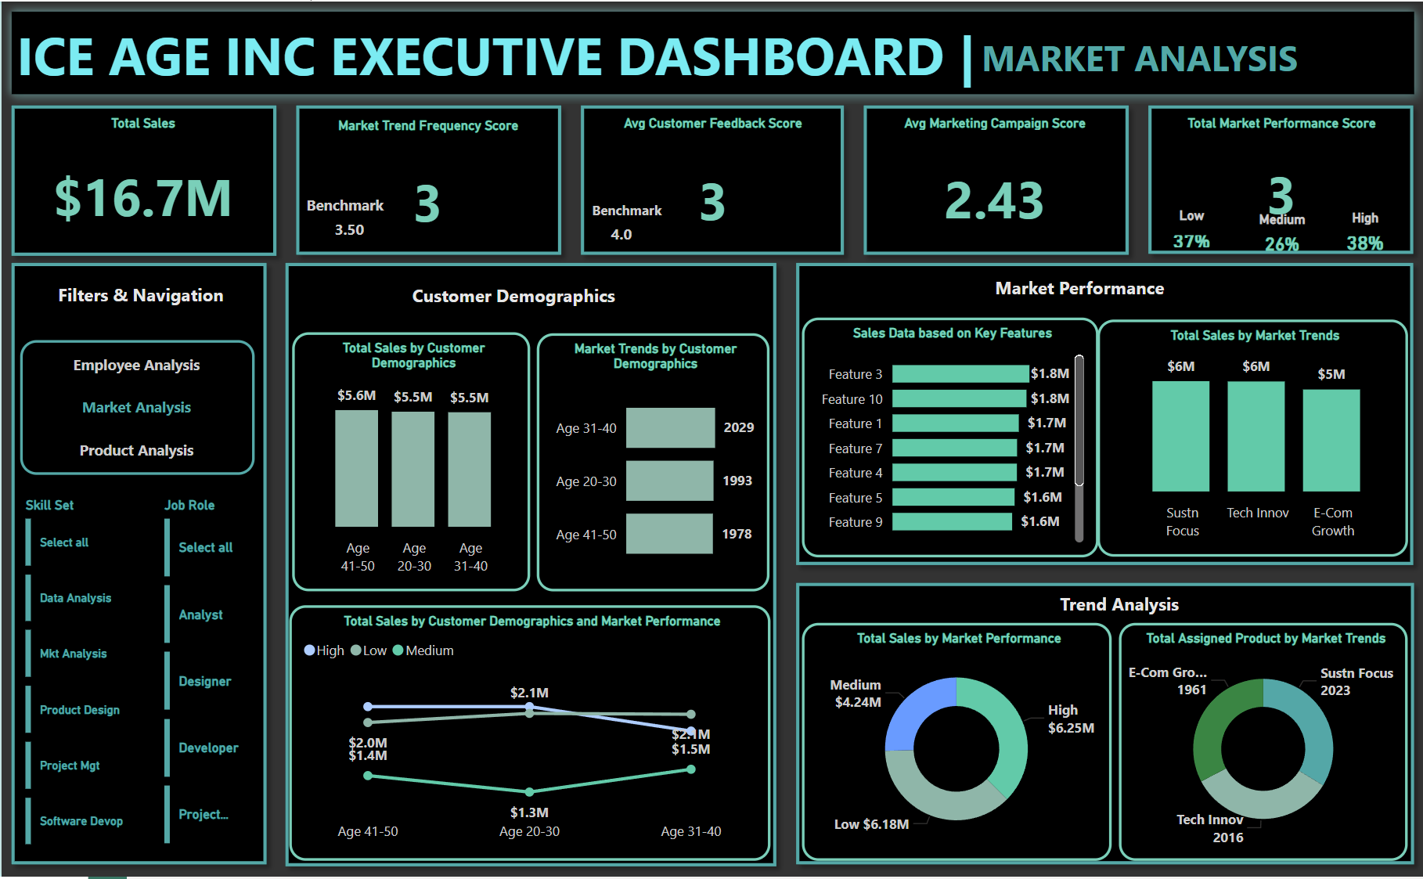

Slide 11
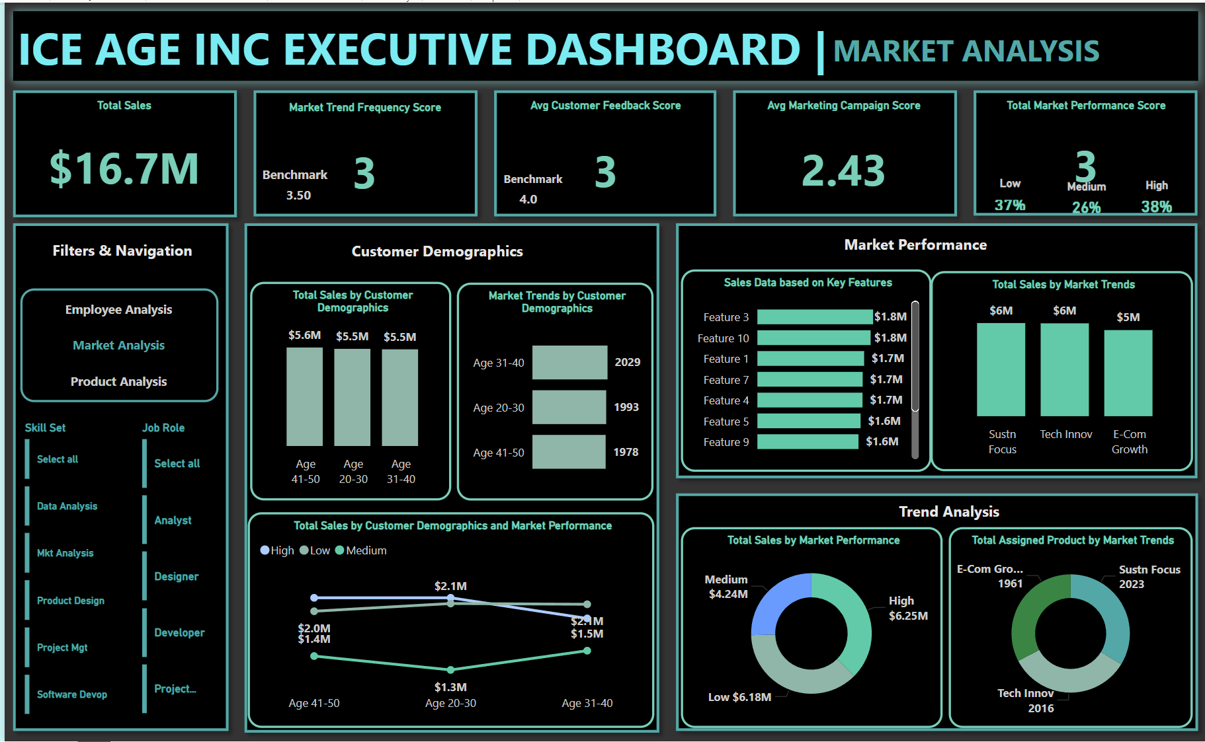
KEY INSIGHTS
Total Sales = $16.7m (Small-Size)
Market Trend Freq Score = 3 (Industry Benchmark = 3.50)
Avg Customer Feedback Score = 3 (Monitor customer satisfaction with the product.)
Total Market Performance Score = 3
Rating: High = 38%, Medium = 26%, Low = 37%
Sales by Mkt Performance = High = $6.25m, Low = $6.18m
Sales by Demographics
Age 41 – 50 Highest = $5.6m
Product with Feature 3 most preferred = $1.8m
Sales by Mkt Trends = Sust Focus and Tech Innovation. = $6m
Market Trends: Products aligned with sustainability focus and Tech Innovation growth trends are outperforming others, suggesting these trends are critical to market success.
Demographic Alignment: Products targeting the 41-50 age demographic are seeing higher sales and customer satisfaction scores, indicating a strong market fit in this segment.
Competitor Positioning: Ice Age Inc.'s products are competitively positioned in terms of market share but lag in certain performance areas when compared to leading competitors.

Slide 12
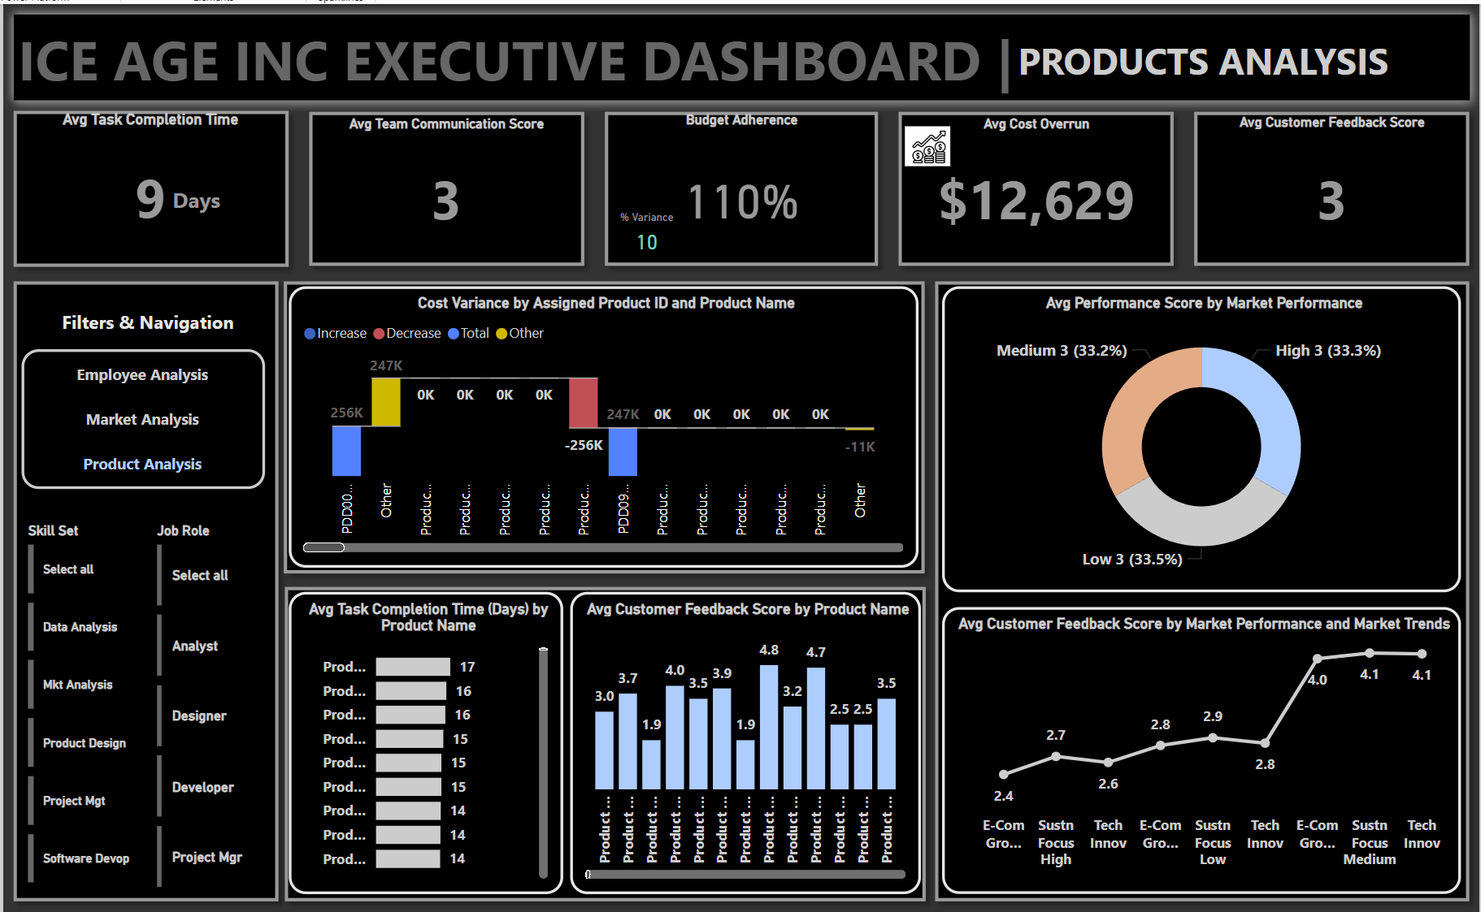

Slide 13
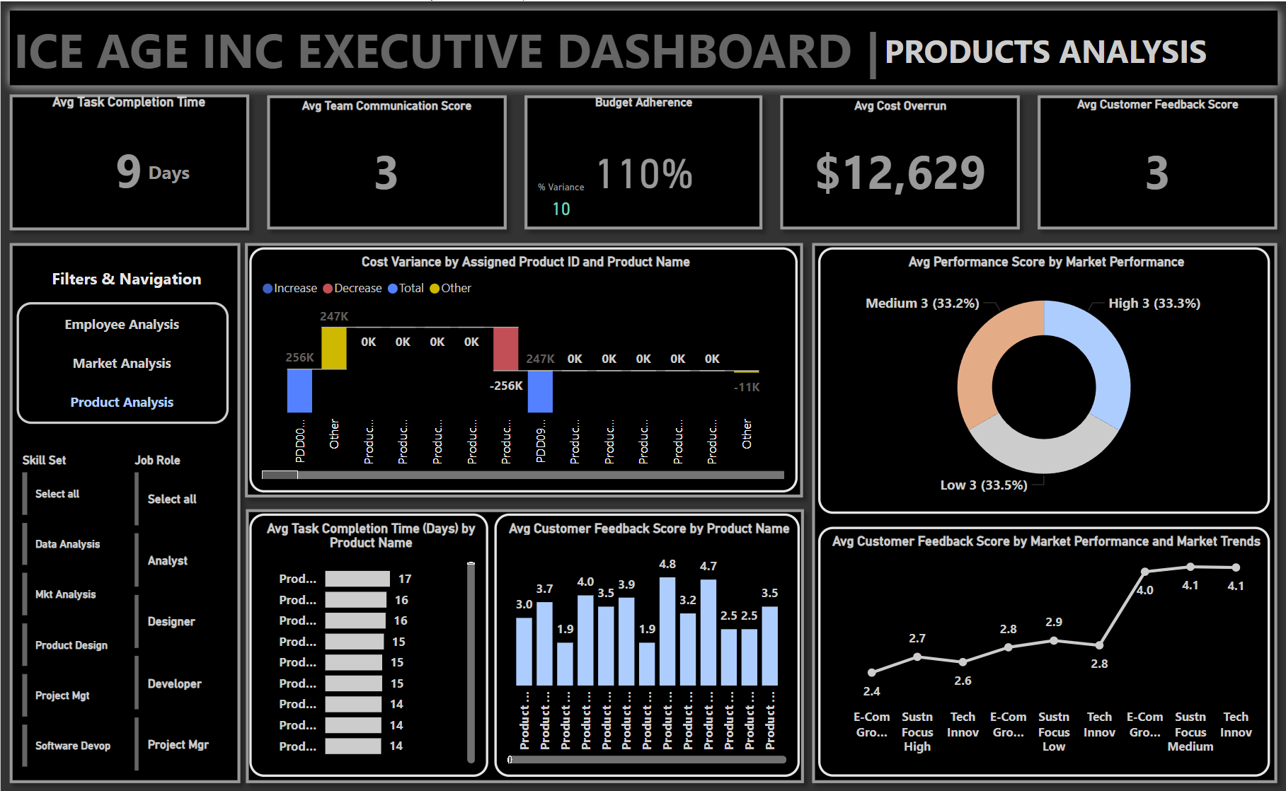
KEY INSIGHTS
Avg Task Completion Time = 9 Days
Budget Adherence 110% Assess how well projects adhere to their budgets by comparing actual costs against budgeted costs.
Cost Variance = 10%
Avg Cost overrun = $12,629
1. Development Efficiency: Products with longer-than-average task completion times are more likely to exceed their budgets and underperform in the market.
2. Budget Adherence: There is a trend of budget overruns for projects that have complex features or involve multiple phases, indicating potential scope creep or underestimation of costs.
3. Market Performance: Products that have received higher customer feedback scores tend to perform better in the market, suggesting a strong correlation between customer satisfaction and market success.

Slide 14

KEY FINDINGS
Cost Overruns: Consistent issues with cost overruns were identified, particularly in the final stages of development due to inefficient resource allocation.
Employee Overload: High employee overload was prevalent, leading to decreased productivity and potential burnout.
Resource Utilization Gaps: Misalignment of employee skills with project needs resulted in underutilization or overload, creating inefficiencies.
Market Fit: Despite internal challenges, products closely aligned with market demands, showed better sales performance and customer satisfaction.

Slide 15
Competitor Analysis:
Market Position: Ice Age Inc. holds a 2% market share in a $1 billion market, comparable to other small-sized competitors.
Competitive Strengths: The company has a strong competitive advantage in customer satisfaction, as indicated by positive feedback scores.
Growth Opportunities: Opportunities for growth include product differentiation, geographic expansion, and strategic partnerships.

Slide 16
Recommendations:
Resource Optimization: Implement a dynamic resource allocation model that adjusts based on project needs and employee availability to reduce overload and improve productivity.
Process Improvements: Streamline the most time-consuming and costly development phases by introducing checkpoints and reviews at critical stages.
Cost Management: Develop a robust cost management framework, including better forecasting, regular budget reviews, and contingency planning.
Market Strategy: Leverage insights from competitor analysis to refine product offerings and align with market trends.

Slide 17
9. Future Work:
Real-Time Data Integration: Incorporate real-time data streams into the development process for more accurate forecasting and dynamic decision-making.
Advanced Analytics: Utilize machine learning to predict project outcomes, identify potential cost overruns, and optimize resource allocation.
Cross-Departmental Collaboration: Enhance collaboration between product development, finance, and HR teams to ensure a cohesive strategy that meets market demands and manages internal resources effectively.

Slide 18
10. Conclusion:
Summary: The project identified significant areas for improvement in Ice Age Inc.'s product development processes, particularly in cost management and employee workload.
Impact: Implementing the recommendations will improve efficiency, reduce costs, and better align products with market demands, ultimately enhancing Ice Age Inc.'s competitive position.
Call to Action: Moving forward, it is essential to focus on resource optimization, process improvements, and strategic market alignment to achieve sustained growth and efficiency.

Slide 19
thank you
09/02/2024

